Slide 1
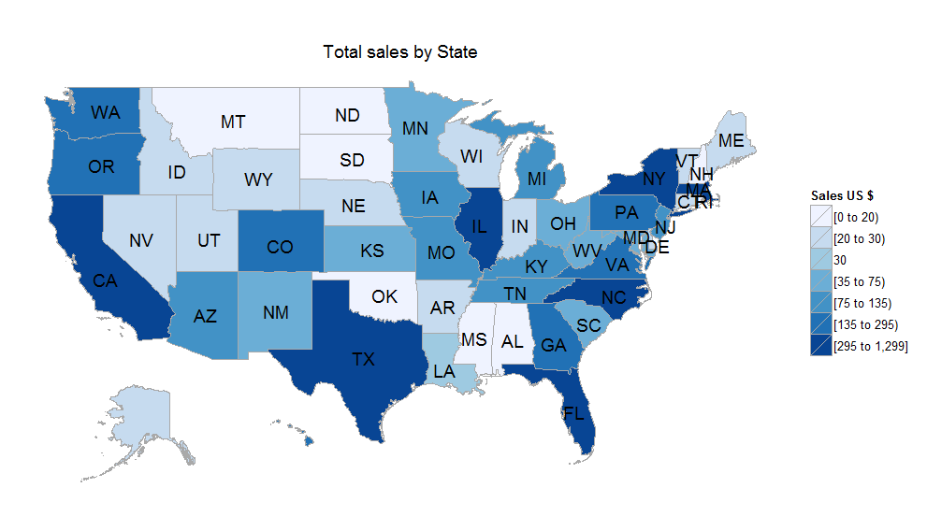
Geospatial Analysis (choroplethr package)
By Mike Jadoo

Slide 2
Purpose
Bring about an awareness
Enable individuals to properly create analysis
Generate geospatial maps

Slide 3
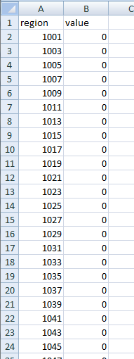
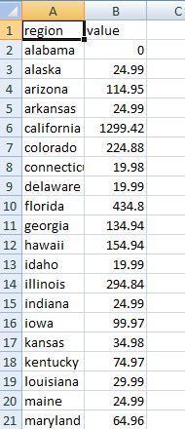
Data Structure
Example of imported table:
County table State table

Slide 4
Creating the map
Which map do you want to make and how many?
-Depends on what are you are analyzing
-Match series with Long/Lat, state and county FIPS code, or zip codes
Notes:
Make sure its in a format that be used easily. Don’t have too many colors.

Slide 5
Finding the data sources
Review the methodology, is this acceptable?
Make your own data
Scale
subdivision

Slide 6
Make your own data-methods
Aggregate: may need to blend data sources
Disaggregate: using ratio’s of relevant data
Percentage change show growth over time
Notes:
(go to excel file)

Slide 7
Creating the map
Some examples using R- Map subdivision
US map with state lines
US map with county lines
State map with county lines

Slide 8
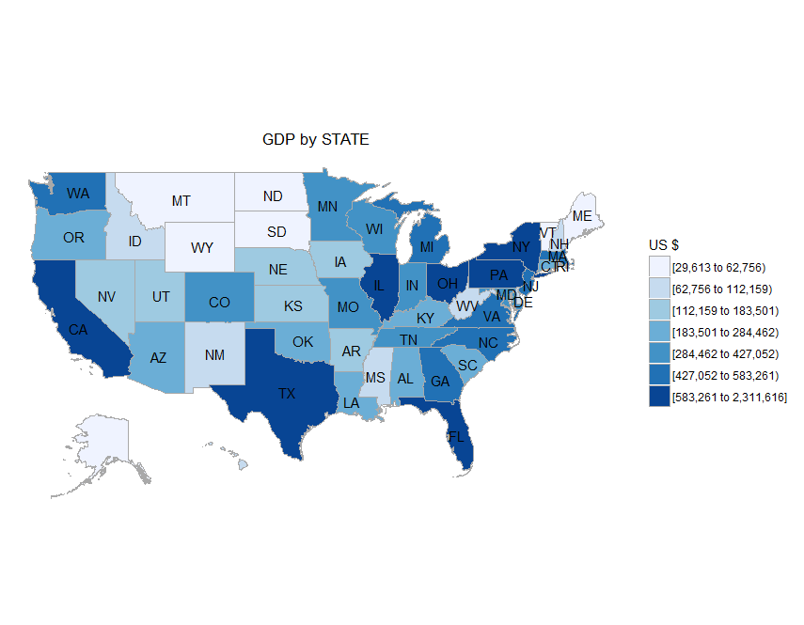
US national map state lines
Starter code:
library(choroplethr)
newdata<-read.csv("E:/COURSE_MATERIAL2/GEO_SPACE/BEA.csv")
state_choropleth(newdata, title = "GDP by STATE“, legend = "US $")

Slide 9
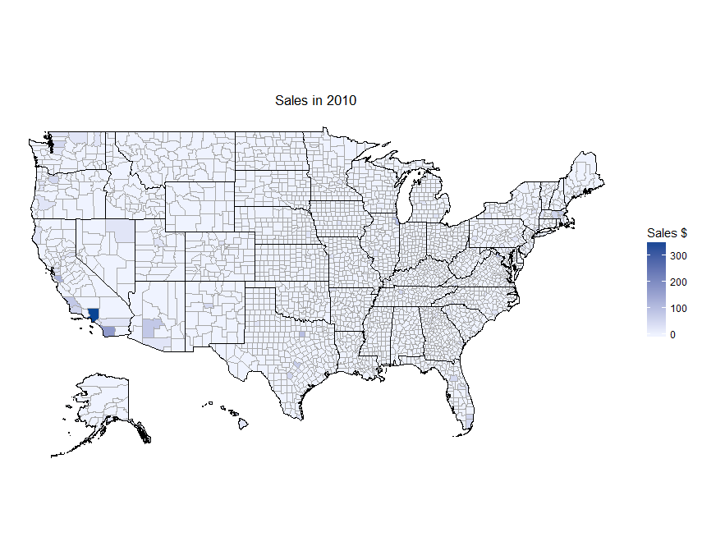
US national map county lines
Starter code:
newdata<-read.csv("E:/COURSE_MATERIAL2/GEO_SPACE/CTY_MAY_MAP_R.csv")
county_choropleth(newdata,title="Total Sales in May", legend="Sales $", num_colors=1)

Slide 10
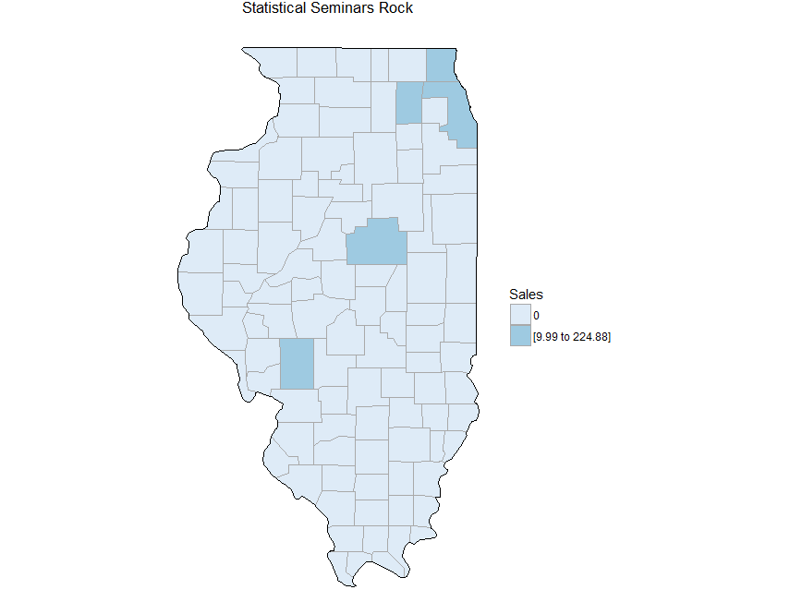
State Map and county lines
Starter code:
library(choroplethr)
newda2ta<-read.csv("E:/COURSE_MATERIAL2/GEO_SPACE/CTY_TOT_SALES_MAP_R.csv")
county_choropleth(newda2ta, state_zoom="illinois", title = "Statistical Seminars Rock",
legend = "Sales",)

Slide 11
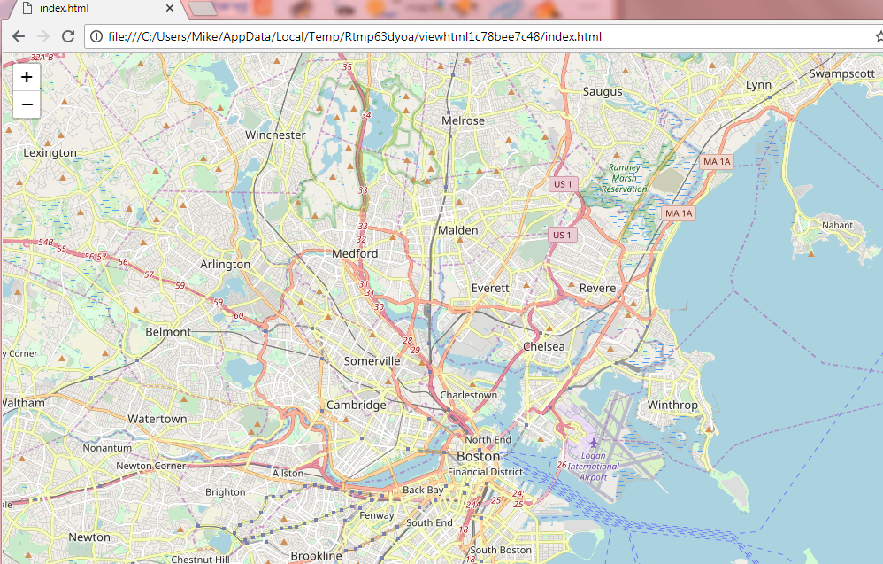
leaflet

Slide 12
?

